Slide 1



PEMBANGUNAN SISTEM INFORMASI MANAJEMEN DAN MARKETING USAHA MAKARONI MASIM BERBASIS WEB
Disusun Oleh :
Elisa Septiani Lubis
NIM : 0204181016
PROGRAM STUDI D3 MANAJEMEN INFORMATIKA
FAKULTAS ILMU KOMPUTER
UNIVERSITAS NASIONAL PASIM
BANDUNG
Notes:
1

Slide 2

POINT PRESENTASI
1
Latar Belakang
2
Identifikasi Masalah
3
Maksud Penelitian
4
Tujuan Penelitian
Perancangan sistem
8
5
Batasan Masalah
Demo Aplikasi
9
6
Model Proses
Kesimpulan & Saran
10
7
Metode Pengembangan sistem

Slide 3

Latar Belakang
Proses transaksi penjualan dan perekapan laporan masih menggunakan proses manual.

Slide 4
Identifikasi Masalah
Bagaimana membuat aplikasi sistem informasi manajemen dan marketing yang dapat menjadi wadah transaksi penjualan, promosi produk dan pengelolaan data secara online.
1
Dalam merekap laporan sering terjadi ketidakakuratan dan ketidaksesuaian data, sehingga membutuhkan waktu yang lama dalam merekap laporan.
2
Dalam pencatatan data-data sering terjadi kesalahan, sehingga data yang dihasilkan tidak akurat.
3

Slide 5


Maksud Penelitian
Maksud dari penelitian ini adalah membangun sistem informasi manajemen dan marketing usaha makaroni masim berbasis web sehingga dapat mempermudah pegawai dalam
proses transaksi penjualan dan perekapan laporan.

Slide 6
Tujuan Penelitian
Membangun sistem informasi yang terkomputerisasi berbasis web yang digunakan untuk mempermudah proses transaksi penjualan secara online dan promosi produk tanpa dibatasi waktu dan tempat
Fitur yang tersedia :
Fitur katalog produk yang membantu pelanggan dalam hal pencarian produk
Fitur transaksi penjualan dengan pembayaran secara online melalui ATM/Bank transfer, Credit/Debit Card, BCA Klik Pay, OCTO Clicks, Indomaret, Alfa Group, Gopay, Shopee Pay dan Akulaku.
Dan pembuatan laporan yang terkomputerisasi sehingga dapat meningkatkan omset penjualan bisnis usaha Makaroni Masim

Slide 7



Batasan Masalah
Platform yang digunakan yaitu web.
Sistem yang dibahas melingkupi informasi tentang profil perusahaan, katalog produk, transaksi penjualan, dan request laporan penjualan atau laporan laba rugi.
Software yang digunakan meliputi: STS sabagai tools, Xampp Control Panel, Database MySQL, Google Chrome/Mozilla Firefox/Microsoft Edge
Website ini hanya menangani transaksi pembayaran melalui ATM/Bank transfer, Credit/Debit Card, BCA Klik Pay, OCTO Clicks, Indomaret, Alfa Group, Gopay, Shopee Pay dan Akulaku yang sudah terintegrasi dengan sistem

Slide 8
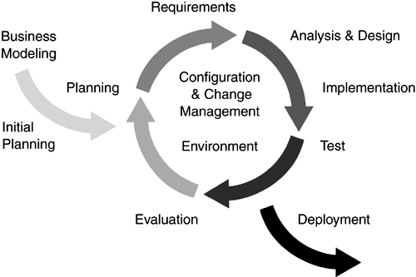
Model Proses
1
Inception (Permulaan)
2
Elaboration (Perencanaan)
3
Construction (Konstruksi)
4
Transition (Transisi)

Slide 9
Metode Pengembangan Sistem
Metode pendekatan system yang dibangun adalah pendekatan berorientasi objek dan pembangunan hasil analisis & desain menggunakan UML :
Use Case Diagram
Activity Diagram
Sequence Diagram
Class Diagram

Slide 10
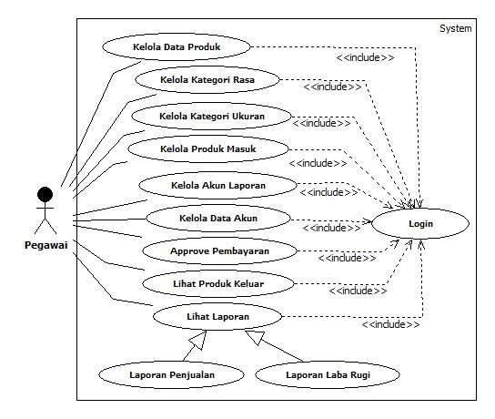
Perancangan Sistem
Pegawai/Admin

Slide 11
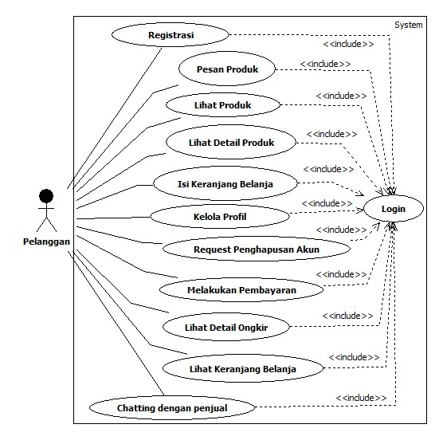
Perancangan Sistem
Pelanggan

Slide 12
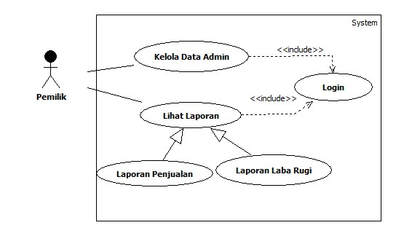
Perancangan Sistem
Pemilik perusahaan

Slide 13
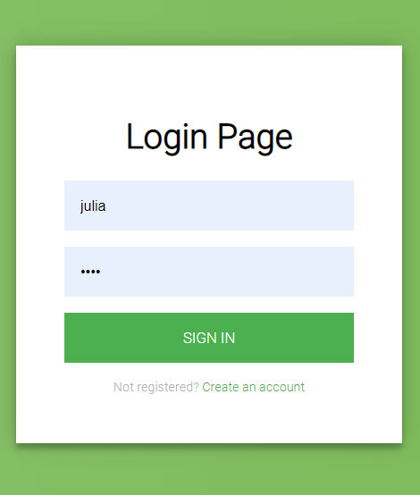
Demo Aplikasi
Halaman Login

Slide 14
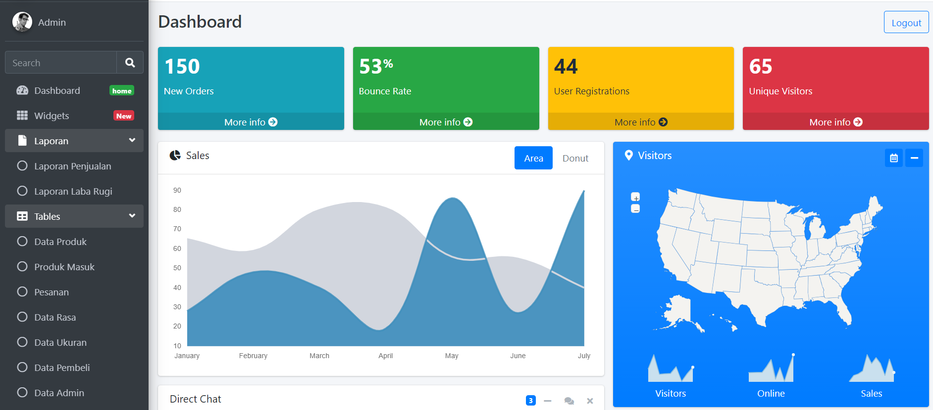
Demo Aplikasi
Halaman Utama Admin

Slide 15
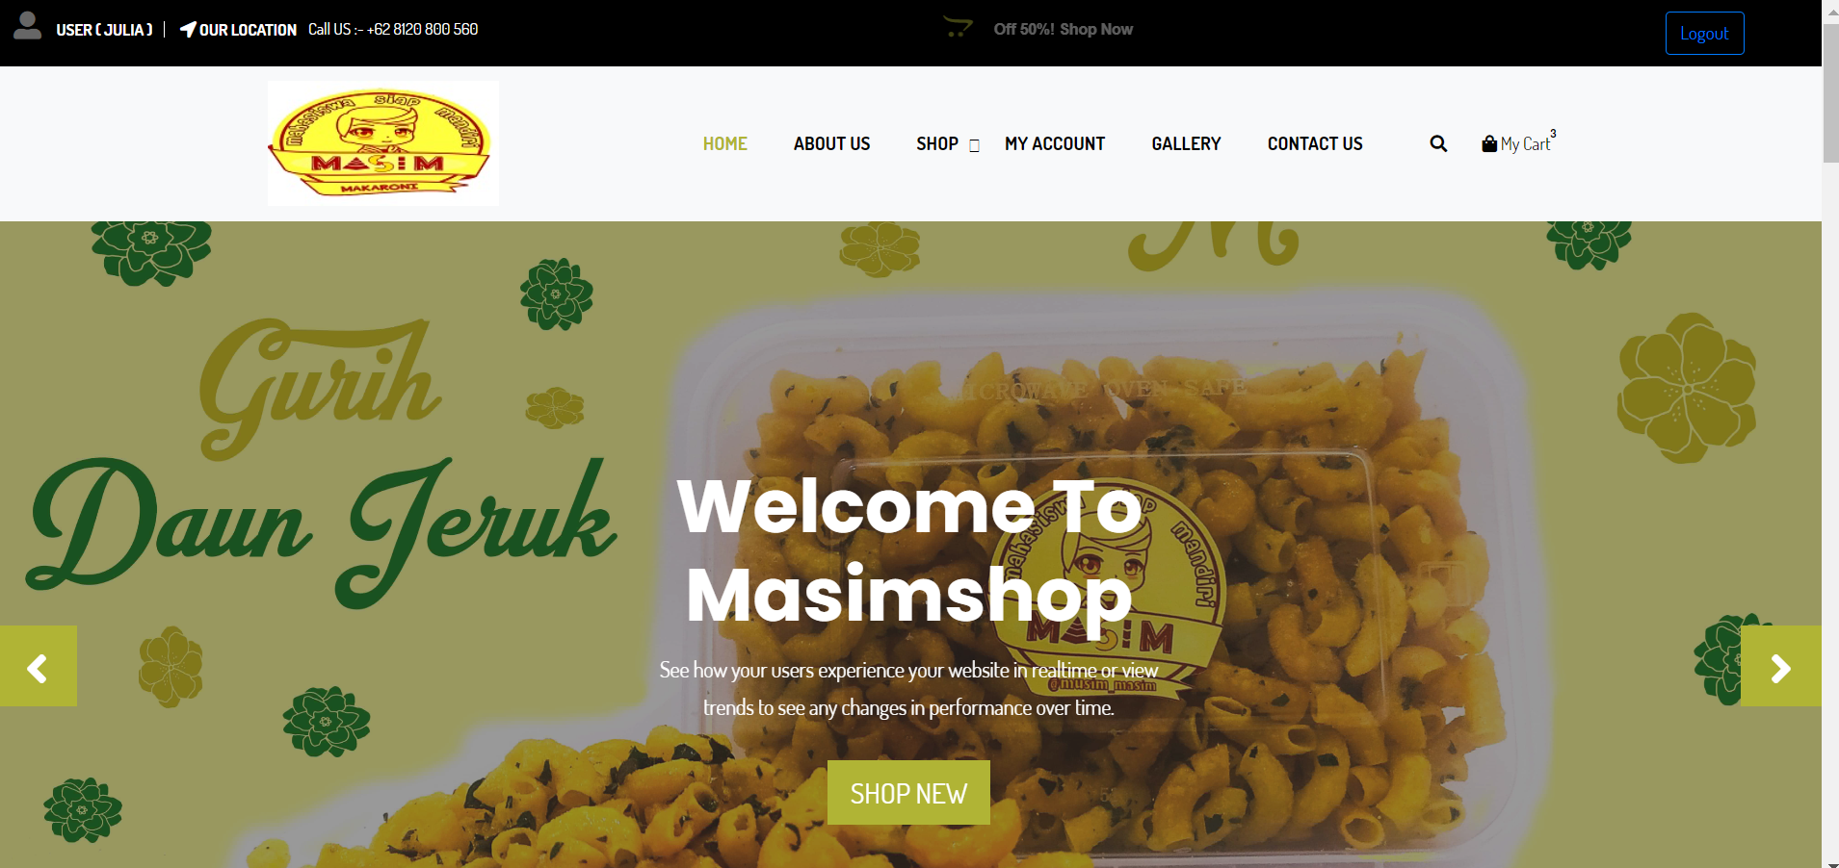
Demo Aplikasi
Halaman Utama Pelanggan

Slide 16
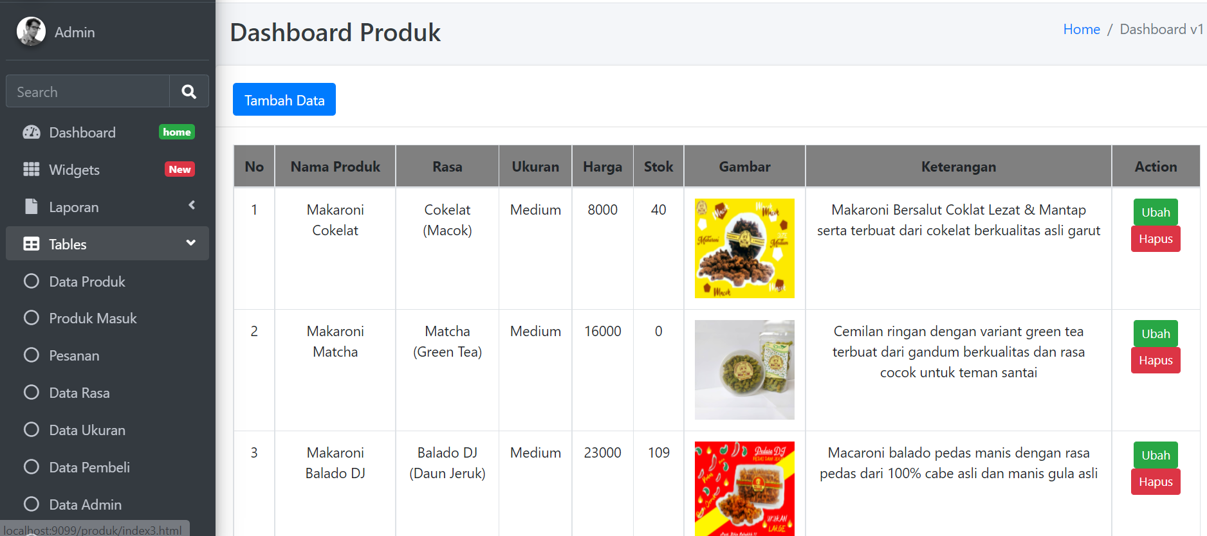
Demo Aplikasi
Halaman Produk
Sales Performance
Service Performance
Sales Honda
Unit Entry
Integrasi data dealer Honda
(termasuk dealer TA)
SSU
Integrasi data
Portal PASTI
Upload data
Portal PASTI
Sale Competitor
Upload foto interior dan exterior dealer
Upload dan maintain data
Sales Polreg
Portal PASTI
Market Share
Upload dan maintain data
Upload data dealer kompetitor
Total Market
Portal PASTI
Upload data fincoy

Slide 17
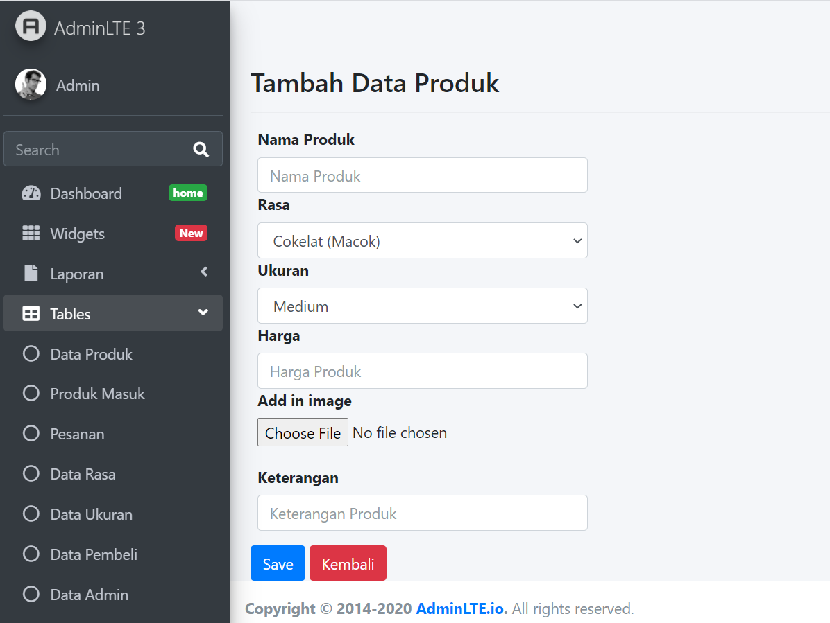
Demo Aplikasi
Halaman Tambah Produk
Sales Performance
Service Performance
Sales Honda
Unit Entry
Integrasi data dealer Honda
(termasuk dealer TA)
SSU
Integrasi data
Portal PASTI
Upload data
Portal PASTI
Sale Competitor
Upload foto interior dan exterior dealer
Upload dan maintain data
Sales Polreg
Portal PASTI
Market Share
Upload dan maintain data
Upload data dealer kompetitor
Total Market
Portal PASTI
Upload data fincoy

Slide 18
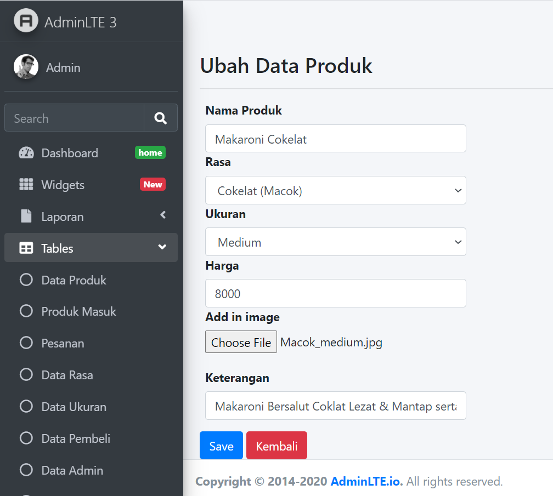
Demo Aplikasi
Halaman Ubah Produk
Sales Performance
Service Performance
Sales Honda
Unit Entry
Integrasi data dealer Honda
(termasuk dealer TA)
SSU
Integrasi data
Portal PASTI
Upload data
Portal PASTI
Sale Competitor
Upload foto interior dan exterior dealer
Upload dan maintain data
Sales Polreg
Portal PASTI
Market Share
Upload dan maintain data
Upload data dealer kompetitor
Total Market
Portal PASTI
Upload data fincoy

Slide 19
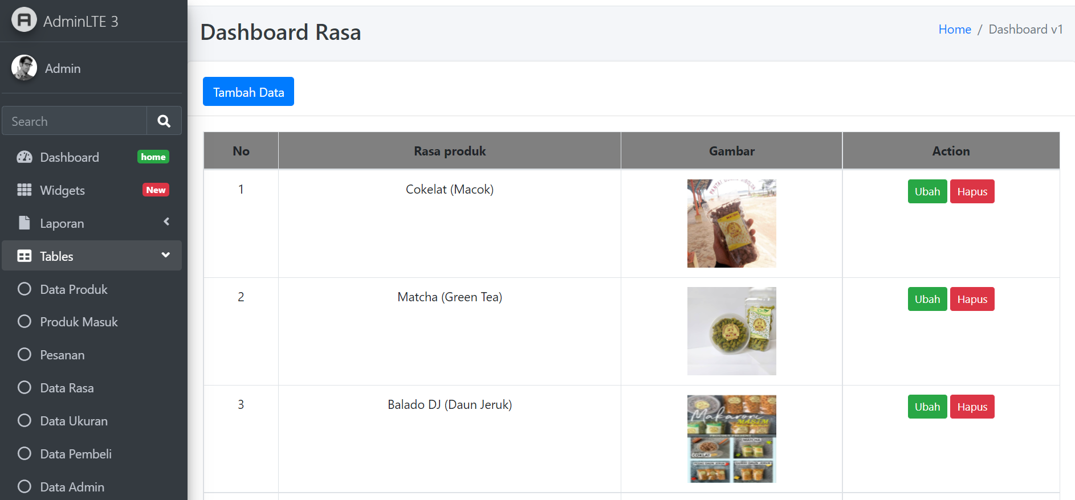
Demo Aplikasi
Halaman Kategori Rasa
Sales Performance
Service Performance
Sales Honda
Unit Entry
Integrasi data dealer Honda
(termasuk dealer TA)
SSU
Integrasi data
Portal PASTI
Upload data
Portal PASTI
Sale Competitor
Upload foto interior dan exterior dealer
Upload dan maintain data
Sales Polreg
Portal PASTI
Market Share
Upload dan maintain data
Upload data dealer kompetitor
Total Market
Portal PASTI
Upload data fincoy

Slide 20
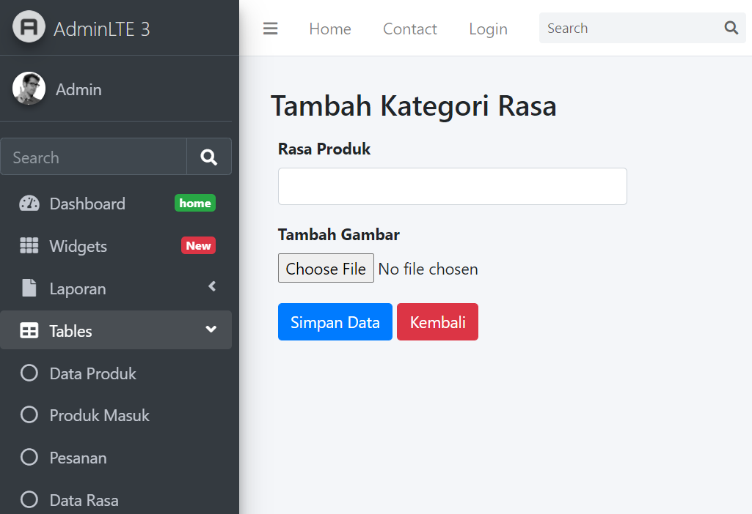
Demo Aplikasi
Halaman Tambah Kategori Rasa
Sales Performance
Service Performance
Sales Honda
Unit Entry
Integrasi data dealer Honda
(termasuk dealer TA)
SSU
Integrasi data
Portal PASTI
Upload data
Portal PASTI
Sale Competitor
Upload foto interior dan exterior dealer
Upload dan maintain data
Sales Polreg
Portal PASTI
Market Share
Upload dan maintain data
Upload data dealer kompetitor
Total Market
Portal PASTI
Upload data fincoy

Slide 21
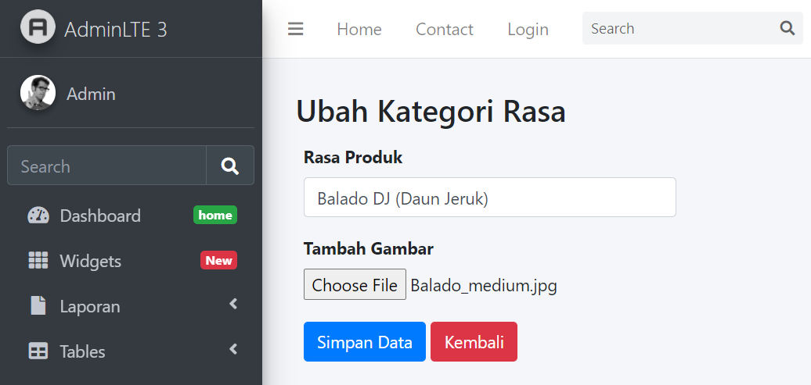
Demo Aplikasi
Halaman Ubah Kategori Rasa
Sales Performance
Service Performance
Sales Honda
Unit Entry
Integrasi data dealer Honda
(termasuk dealer TA)
SSU
Integrasi data
Portal PASTI
Upload data
Portal PASTI
Sale Competitor
Upload foto interior dan exterior dealer
Upload dan maintain data
Sales Polreg
Portal PASTI
Market Share
Upload dan maintain data
Upload data dealer kompetitor
Total Market
Portal PASTI
Upload data fincoy

Slide 22
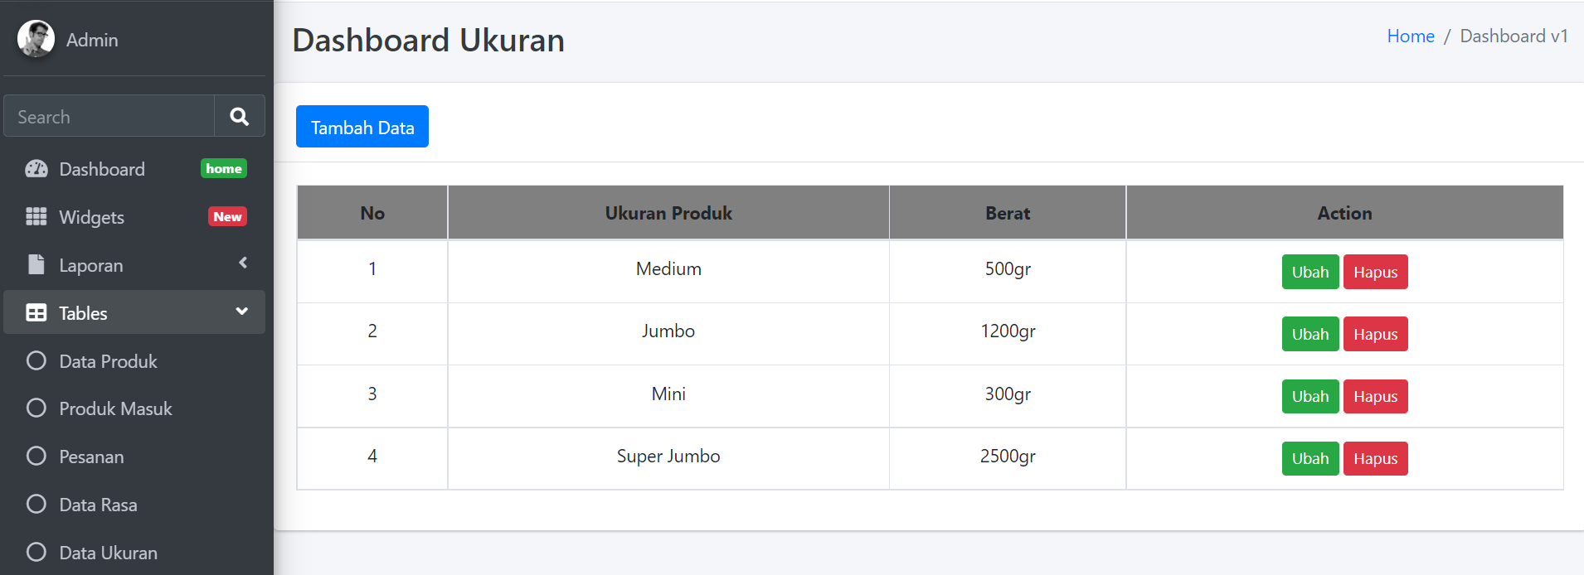
Demo Aplikasi
Halaman Kategori Ukuran
Sales Performance
Service Performance
Sales Honda
Unit Entry
Integrasi data dealer Honda
(termasuk dealer TA)
SSU
Integrasi data
Portal PASTI
Upload data
Portal PASTI
Sale Competitor
Upload foto interior dan exterior dealer
Upload dan maintain data
Sales Polreg
Portal PASTI
Market Share
Upload dan maintain data
Upload data dealer kompetitor
Total Market
Portal PASTI
Upload data fincoy

Slide 23
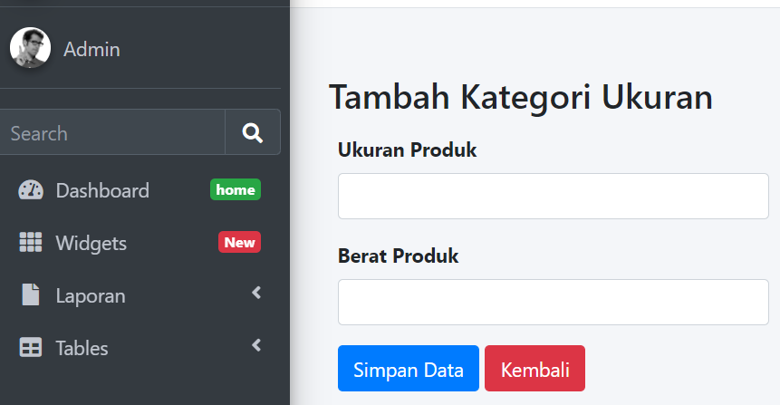
Demo Aplikasi
Halaman Tambah Kategori Ukuran
Sales Performance
Service Performance
Sales Honda
Unit Entry
Integrasi data dealer Honda
(termasuk dealer TA)
SSU
Integrasi data
Portal PASTI
Upload data
Portal PASTI
Sale Competitor
Upload foto interior dan exterior dealer
Upload dan maintain data
Sales Polreg
Portal PASTI
Market Share
Upload dan maintain data
Upload data dealer kompetitor
Total Market
Portal PASTI
Upload data fincoy

Slide 24
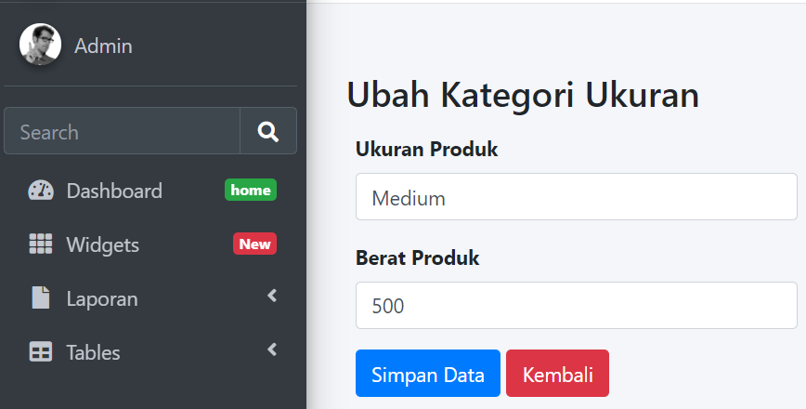
Demo Aplikasi
Halaman Ubah Kategori Ukuran
Sales Performance
Service Performance
Sales Honda
Unit Entry
Integrasi data dealer Honda
(termasuk dealer TA)
SSU
Integrasi data
Portal PASTI
Upload data
Portal PASTI
Sale Competitor
Upload foto interior dan exterior dealer
Upload dan maintain data
Sales Polreg
Portal PASTI
Market Share
Upload dan maintain data
Upload data dealer kompetitor
Total Market
Portal PASTI
Upload data fincoy

Slide 25
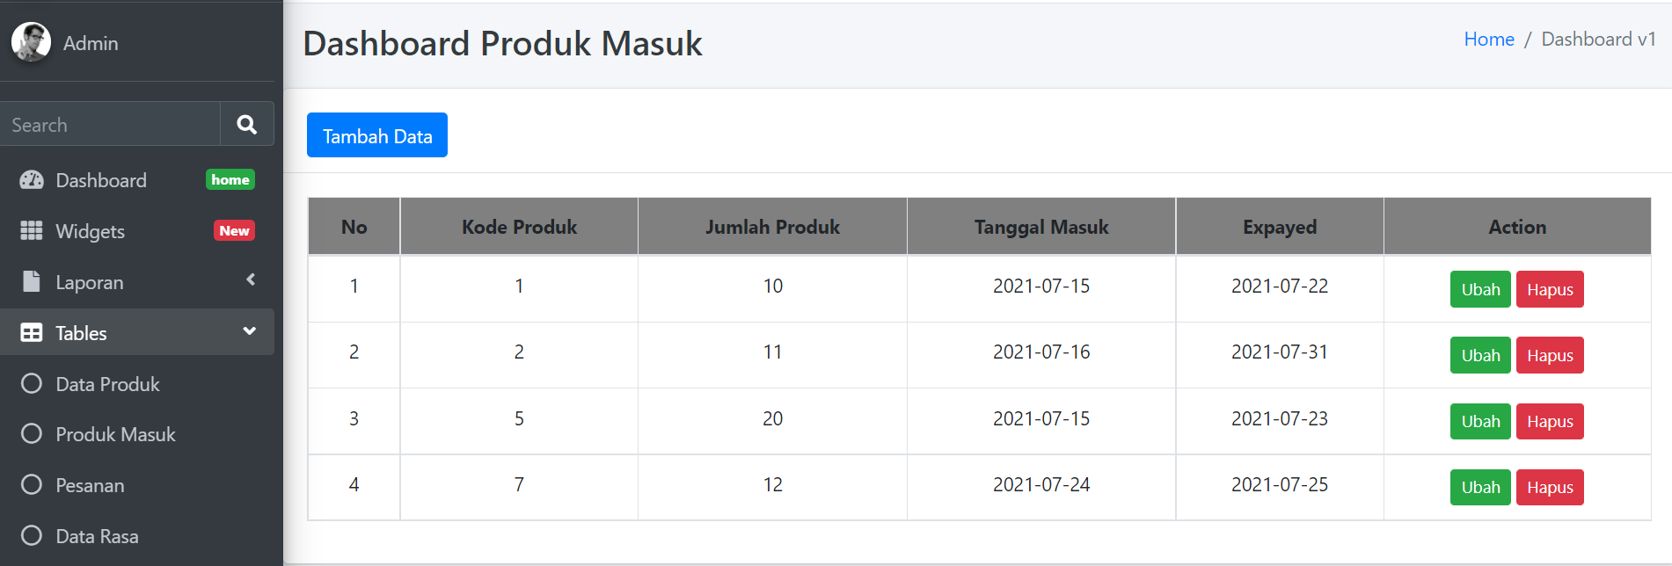
Demo Aplikasi
Halaman Data Produk Masuk
Sales Performance
Service Performance
Sales Honda
Unit Entry
Integrasi data dealer Honda
(termasuk dealer TA)
SSU
Integrasi data
Portal PASTI
Upload data
Portal PASTI
Sale Competitor
Upload foto interior dan exterior dealer
Upload dan maintain data
Sales Polreg
Portal PASTI
Market Share
Upload dan maintain data
Upload data dealer kompetitor
Total Market
Portal PASTI
Upload data fincoy

Slide 26
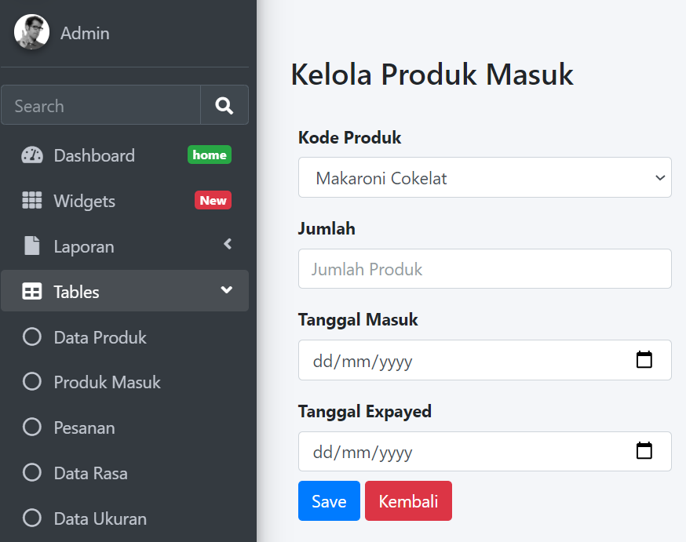
Demo Aplikasi
Halaman Tambah Produk Masuk
Sales Performance
Service Performance
Sales Honda
Unit Entry
Integrasi data dealer Honda
(termasuk dealer TA)
SSU
Integrasi data
Portal PASTI
Upload data
Portal PASTI
Sale Competitor
Upload foto interior dan exterior dealer
Upload dan maintain data
Sales Polreg
Portal PASTI
Market Share
Upload dan maintain data
Upload data dealer kompetitor
Total Market
Portal PASTI
Upload data fincoy

Slide 27
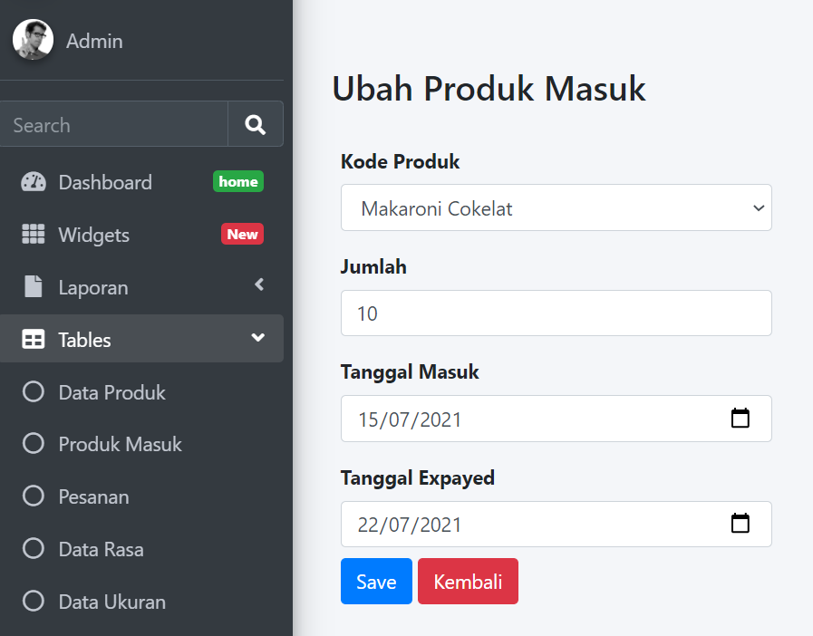
Demo Aplikasi
Halaman Ubah Produk Masuk
Sales Performance
Service Performance
Sales Honda
Unit Entry
Integrasi data dealer Honda
(termasuk dealer TA)
SSU
Integrasi data
Portal PASTI
Upload data
Portal PASTI
Sale Competitor
Upload foto interior dan exterior dealer
Upload dan maintain data
Sales Polreg
Portal PASTI
Market Share
Upload dan maintain data
Upload data dealer kompetitor
Total Market
Portal PASTI
Upload data fincoy

Slide 28
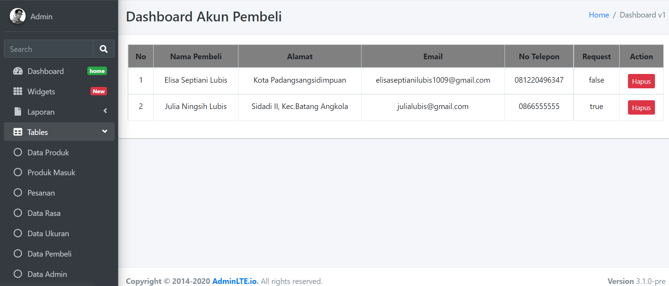
Demo Aplikasi
Halaman Data Pelanggan
Sales Performance
Service Performance
Sales Honda
Unit Entry
Integrasi data dealer Honda
(termasuk dealer TA)
SSU
Integrasi data
Portal PASTI
Upload data
Portal PASTI
Sale Competitor
Upload foto interior dan exterior dealer
Upload dan maintain data
Sales Polreg
Portal PASTI
Market Share
Upload dan maintain data
Upload data dealer kompetitor
Total Market
Portal PASTI
Upload data fincoy

Slide 29
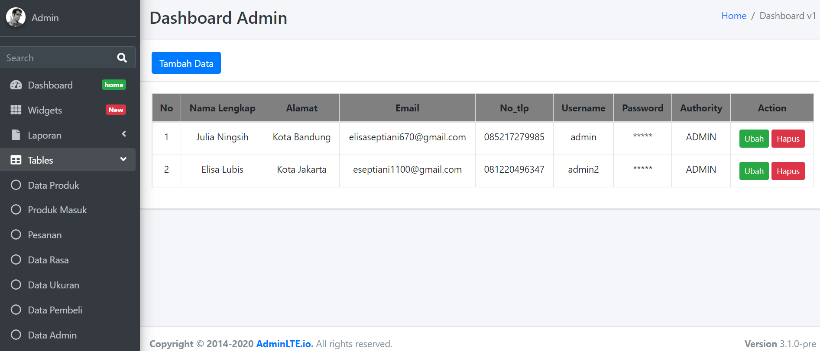
Demo Aplikasi
Halaman Data Admin
Sales Performance
Service Performance
Sales Honda
Unit Entry
Integrasi data dealer Honda
(termasuk dealer TA)
SSU
Integrasi data
Portal PASTI
Upload data
Portal PASTI
Sale Competitor
Upload foto interior dan exterior dealer
Upload dan maintain data
Sales Polreg
Portal PASTI
Market Share
Upload dan maintain data
Upload data dealer kompetitor
Total Market
Portal PASTI
Upload data fincoy

Slide 30
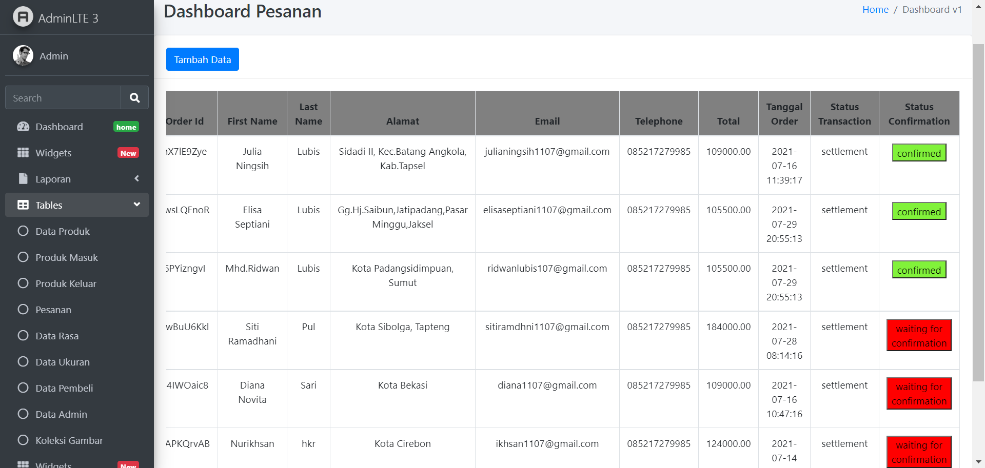
Demo Aplikasi
Halaman Data Pesanan
Sales Performance
Service Performance
Sales Honda
Unit Entry
Integrasi data dealer Honda
(termasuk dealer TA)
SSU
Integrasi data
Portal PASTI
Upload data
Portal PASTI
Sale Competitor
Upload foto interior dan exterior dealer
Upload dan maintain data
Sales Polreg
Portal PASTI
Market Share
Upload dan maintain data
Upload data dealer kompetitor
Total Market
Portal PASTI
Upload data fincoy

Slide 31
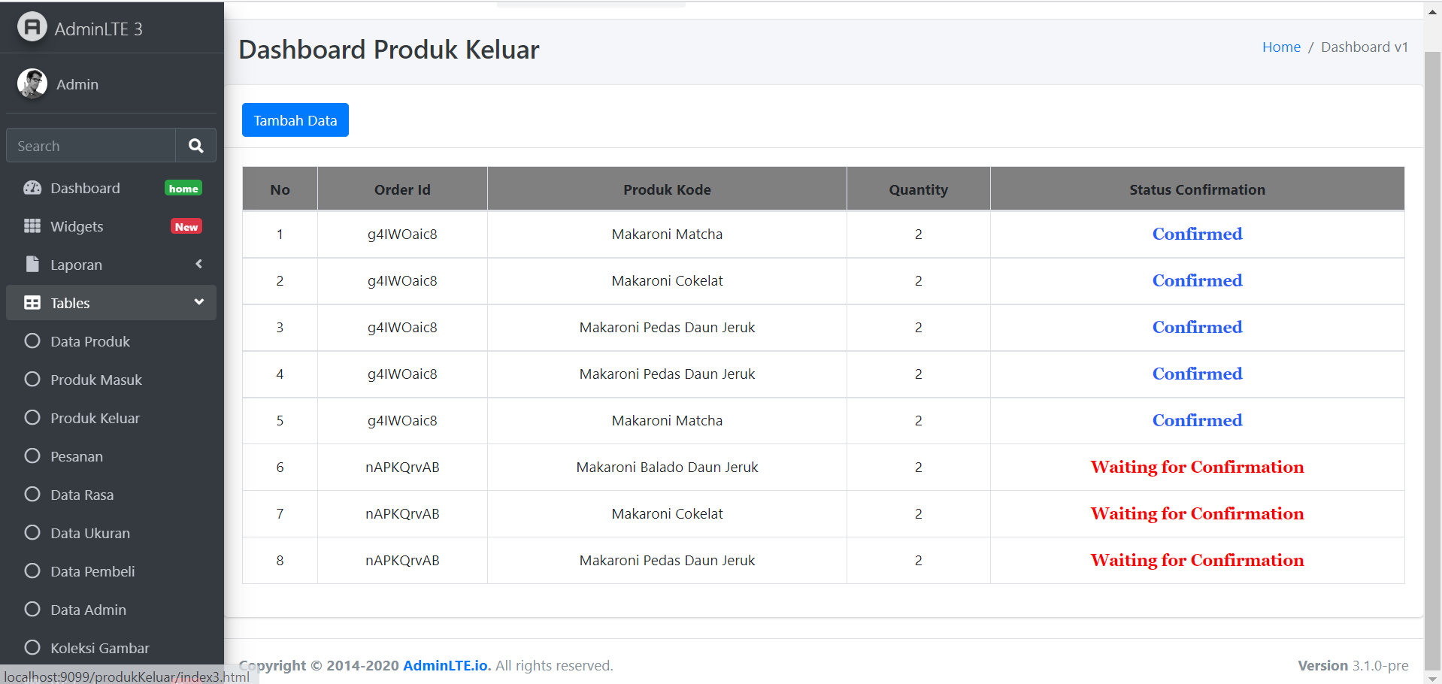
Demo Aplikasi
Halaman Data Produk Keluar
Sales Performance
Service Performance
Sales Honda
Unit Entry
Integrasi data dealer Honda
(termasuk dealer TA)
SSU
Integrasi data
Portal PASTI
Upload data
Portal PASTI
Sale Competitor
Upload foto interior dan exterior dealer
Upload dan maintain data
Sales Polreg
Portal PASTI
Market Share
Upload dan maintain data
Upload data dealer kompetitor
Total Market
Portal PASTI
Upload data fincoy

Slide 32
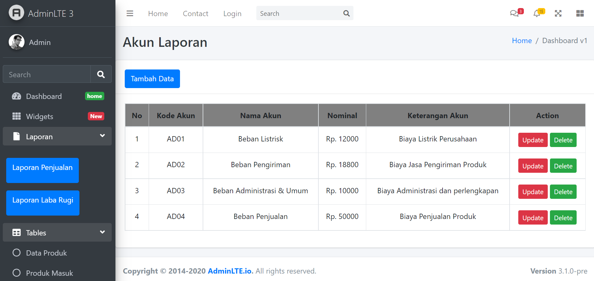
Demo Aplikasi
Halaman Data Akun Laporan
Sales Performance
Service Performance
Sales Honda
Unit Entry
Integrasi data dealer Honda
(termasuk dealer TA)
SSU
Integrasi data
Portal PASTI
Upload data
Portal PASTI
Sale Competitor
Upload foto interior dan exterior dealer
Upload dan maintain data
Sales Polreg
Portal PASTI
Market Share
Upload dan maintain data
Upload data dealer kompetitor
Total Market
Portal PASTI
Upload data fincoy

Slide 33
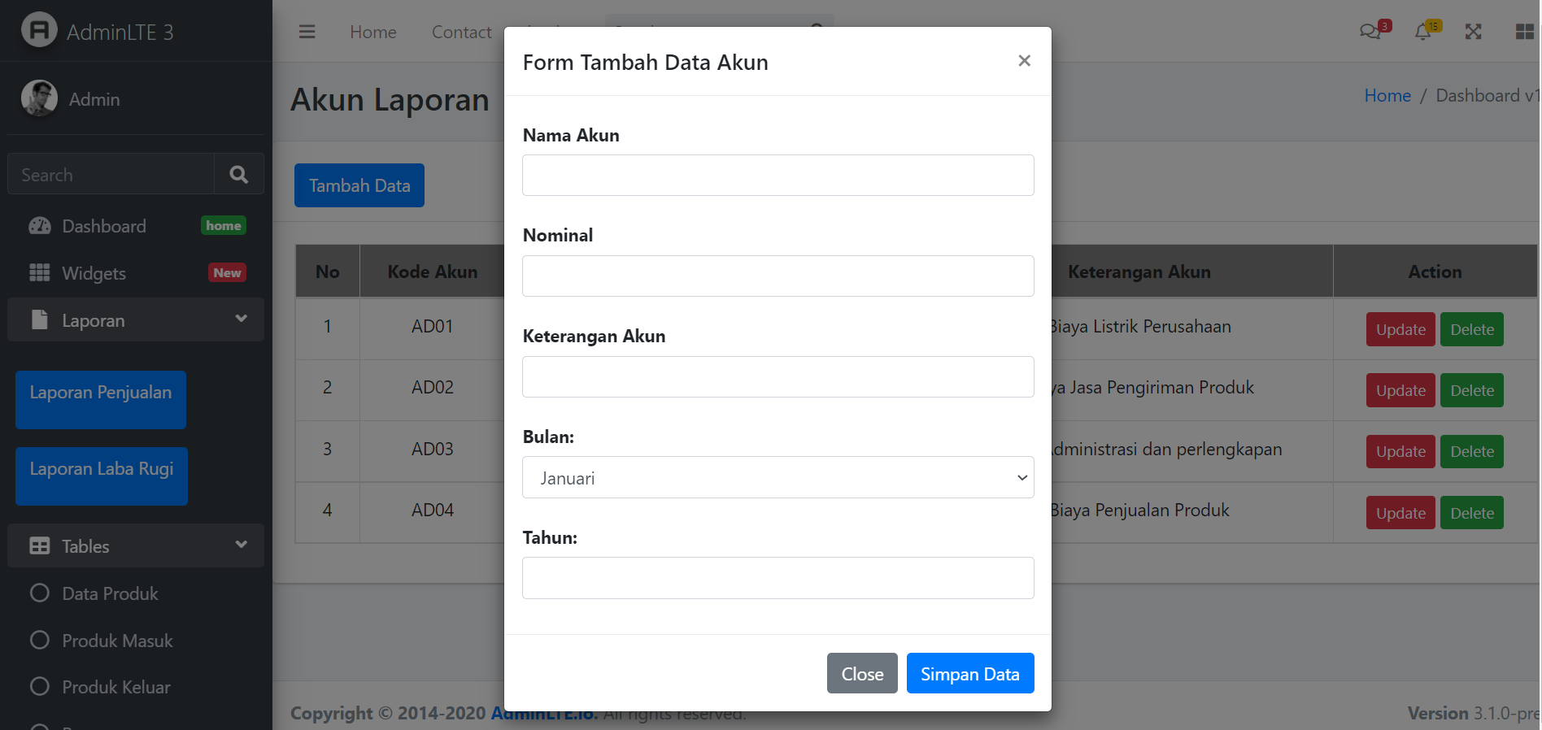
Demo Aplikasi
Halaman Tambah Akun Laporan
Sales Performance
Service Performance
Sales Honda
Unit Entry
Integrasi data dealer Honda
(termasuk dealer TA)
SSU
Integrasi data
Portal PASTI
Upload data
Portal PASTI
Sale Competitor
Upload foto interior dan exterior dealer
Upload dan maintain data
Sales Polreg
Portal PASTI
Market Share
Upload dan maintain data
Upload data dealer kompetitor
Total Market
Portal PASTI
Upload data fincoy

Slide 34
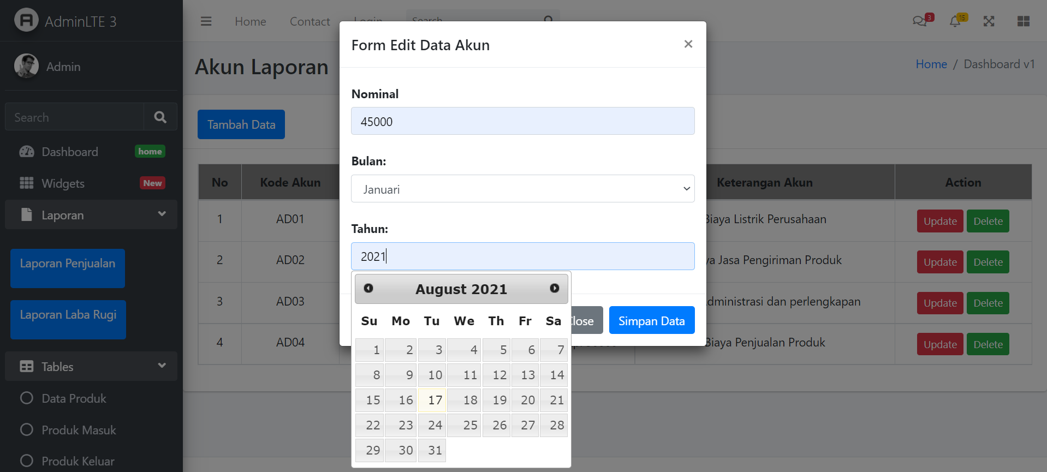
Demo Aplikasi
Halaman Ubah Akun Laporan
Sales Performance
Service Performance
Sales Honda
Unit Entry
Integrasi data dealer Honda
(termasuk dealer TA)
SSU
Integrasi data
Portal PASTI
Upload data
Portal PASTI
Sale Competitor
Upload foto interior dan exterior dealer
Upload dan maintain data
Sales Polreg
Portal PASTI
Market Share
Upload dan maintain data
Upload data dealer kompetitor
Total Market
Portal PASTI
Upload data fincoy

Slide 35
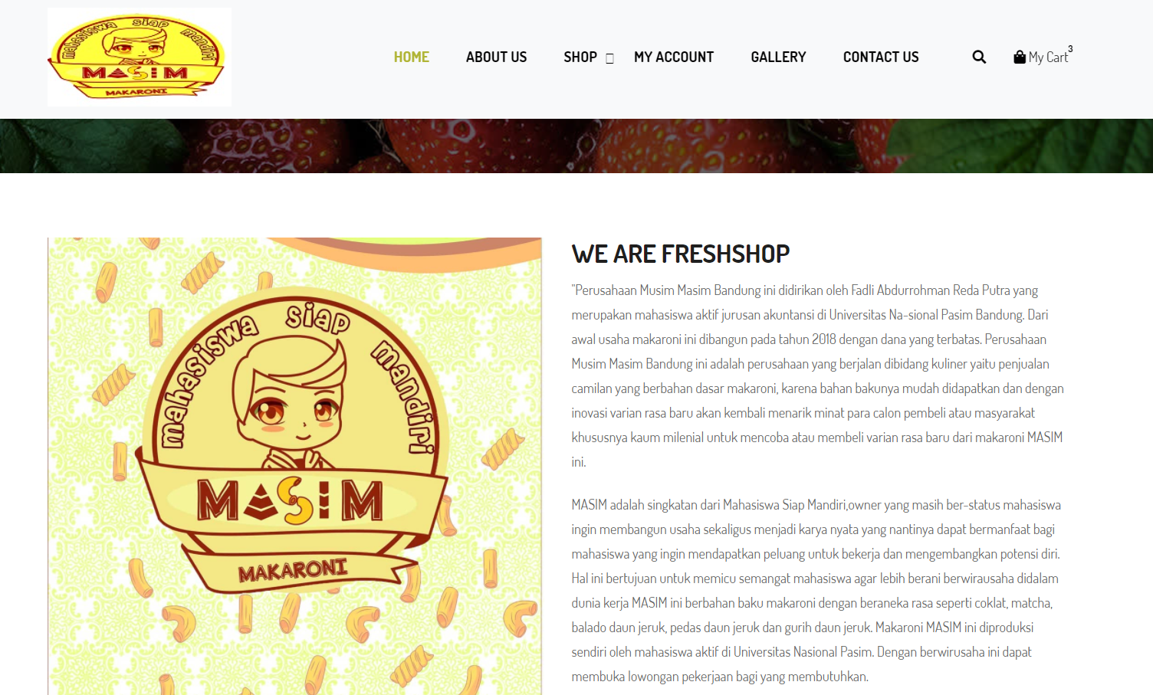
Demo Aplikasi
Halaman Profil Perusahaan
Sales Performance
Service Performance
Sales Honda
Unit Entry
Integrasi data dealer Honda
(termasuk dealer TA)
SSU
Integrasi data
Portal PASTI
Upload data
Portal PASTI
Sale Competitor
Upload foto interior dan exterior dealer
Upload dan maintain data
Sales Polreg
Portal PASTI
Market Share
Upload dan maintain data
Upload data dealer kompetitor
Total Market
Portal PASTI
Upload data fincoy

Slide 36
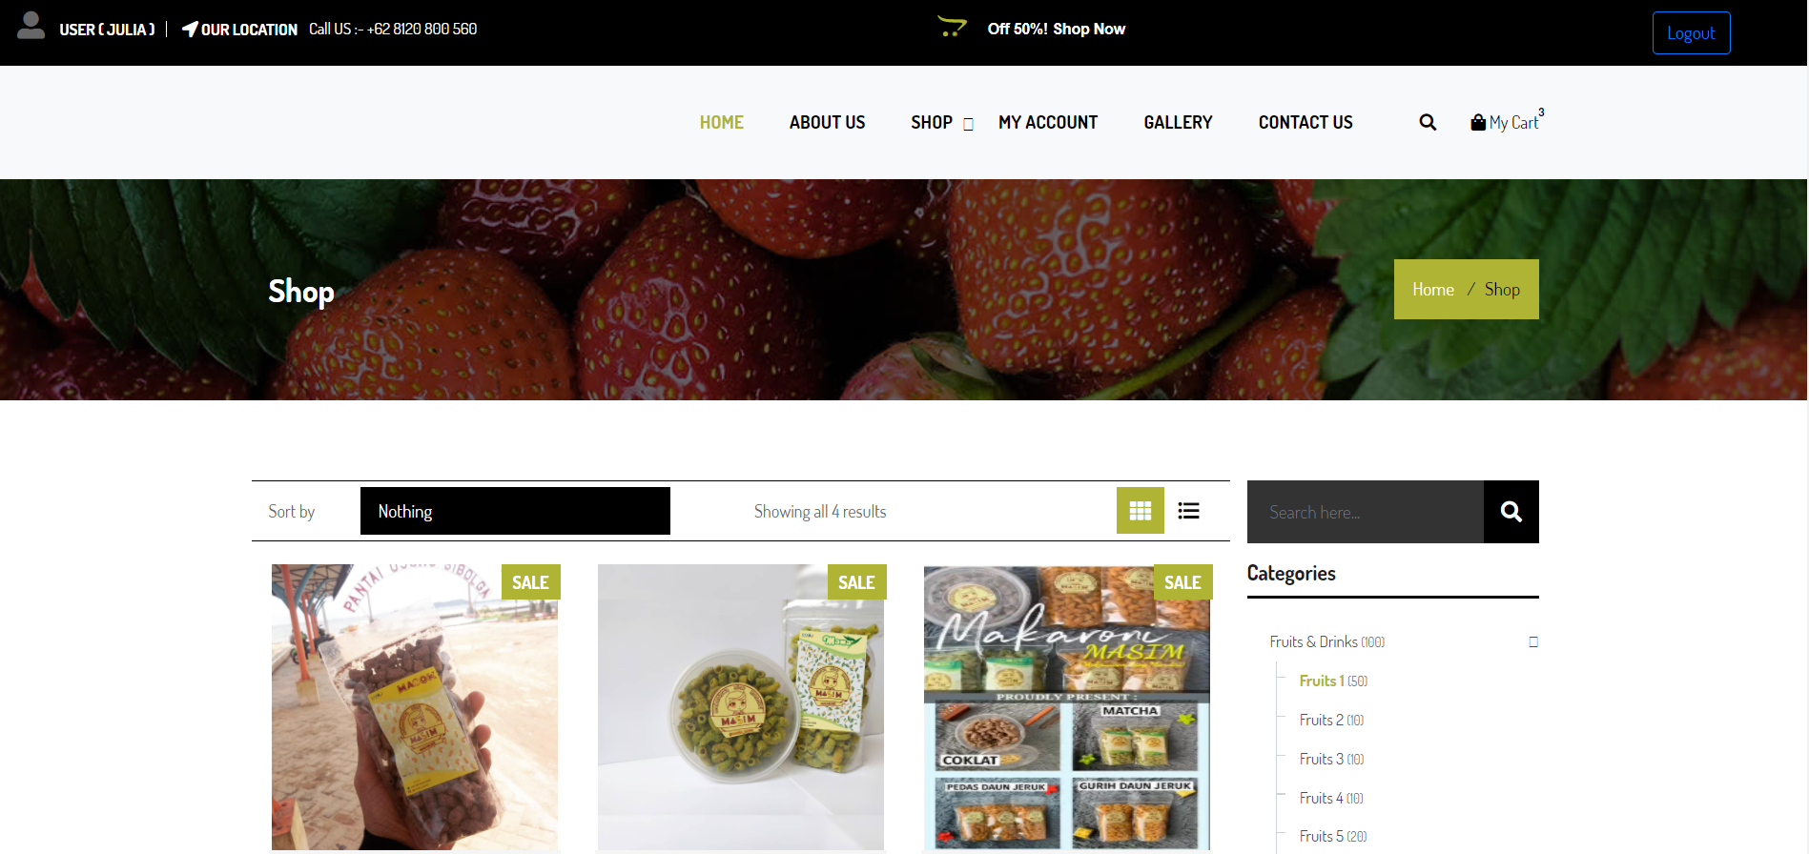
Demo Aplikasi
Halaman Katalog
Sales Performance
Service Performance
Sales Honda
Unit Entry
Integrasi data dealer Honda
(termasuk dealer TA)
SSU
Integrasi data
Portal PASTI
Upload data
Portal PASTI
Sale Competitor
Upload foto interior dan exterior dealer
Upload dan maintain data
Sales Polreg
Portal PASTI
Market Share
Upload dan maintain data
Upload data dealer kompetitor
Total Market
Portal PASTI
Upload data fincoy

Slide 37
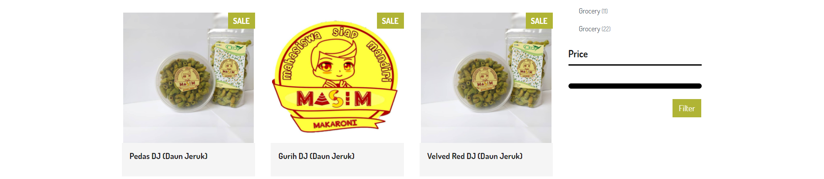
Demo Aplikasi
Halaman Katalog
Sales Performance
Service Performance
Sales Honda
Unit Entry
Integrasi data dealer Honda
(termasuk dealer TA)
SSU
Integrasi data
Portal PASTI
Upload data
Portal PASTI
Sale Competitor
Upload foto interior dan exterior dealer
Upload dan maintain data
Sales Polreg
Portal PASTI
Market Share
Upload dan maintain data
Upload data dealer kompetitor
Total Market
Portal PASTI
Upload data fincoy

Slide 38
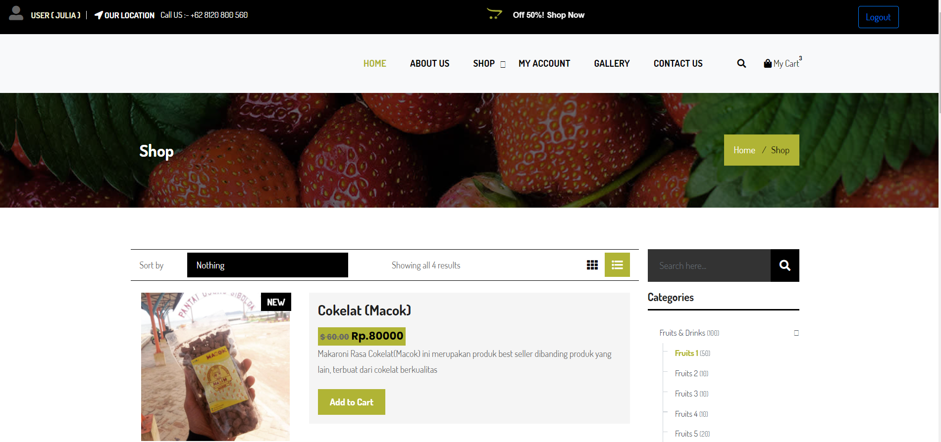
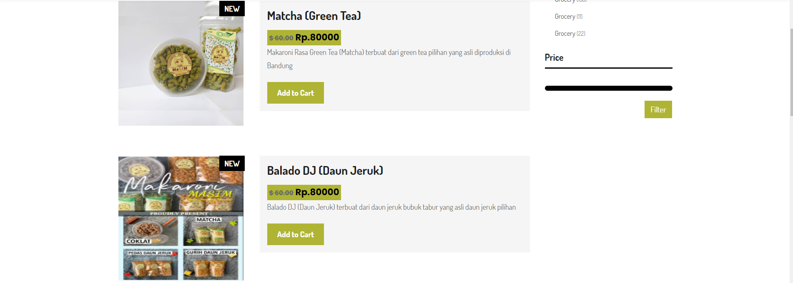
Demo Aplikasi
Halaman Detail Produk
Sales Performance
Service Performance
Sales Honda
Unit Entry
Integrasi data dealer Honda
(termasuk dealer TA)
SSU
Integrasi data
Portal PASTI
Upload data
Portal PASTI
Sale Competitor
Upload dan maintain data
Sales Polreg
Portal PASTI
Market Share
Upload dan maintain data
Upload data dealer kompetitor
Total Market
Portal PASTI
Upload data fincoy

Slide 39
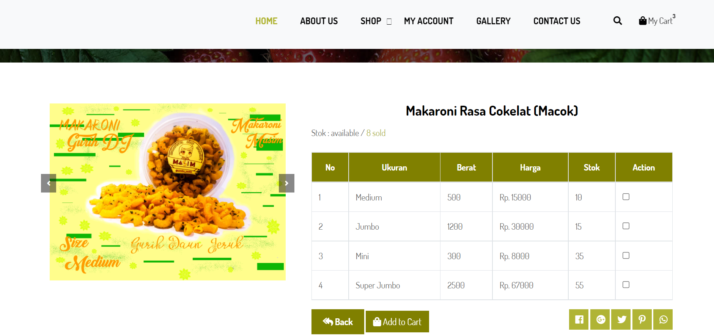
Demo Aplikasi
Halaman Pilih Produk
Sales Performance
Service Performance
Sales Honda
Unit Entry
Integrasi data dealer Honda
(termasuk dealer TA)
SSU
Integrasi data
Portal PASTI
Upload data
Portal PASTI
Sale Competitor
Upload dan maintain data
Sales Polreg
Portal PASTI
Market Share
Upload dan maintain data
Upload data dealer kompetitor
Total Market
Portal PASTI
Upload data fincoy

Slide 40
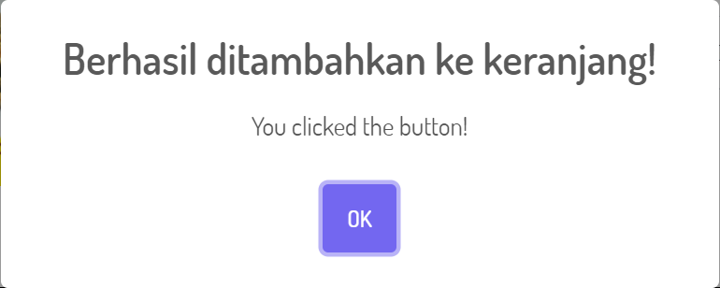
Demo Aplikasi
Notifikasi Sukses Tambah Cart
Sales Performance
Service Performance
Sales Honda
Unit Entry
Integrasi data dealer Honda
(termasuk dealer TA)
SSU
Integrasi data
Portal PASTI
Upload data
Portal PASTI
Sale Competitor
Upload dan maintain data
Sales Polreg
Portal PASTI
Market Share
Upload dan maintain data
Upload data dealer kompetitor
Total Market
Portal PASTI
Upload data fincoy

Slide 41
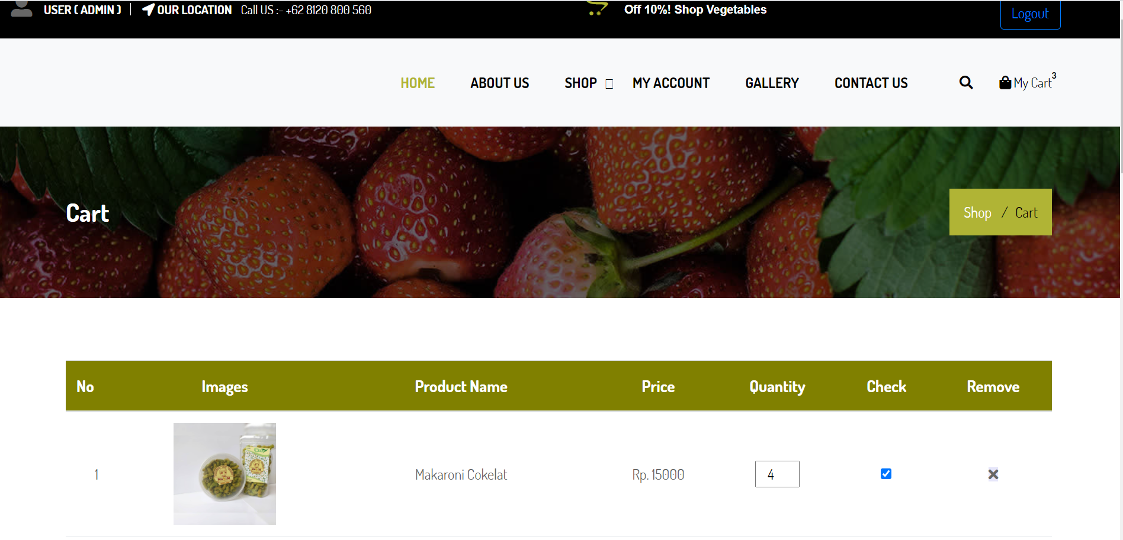
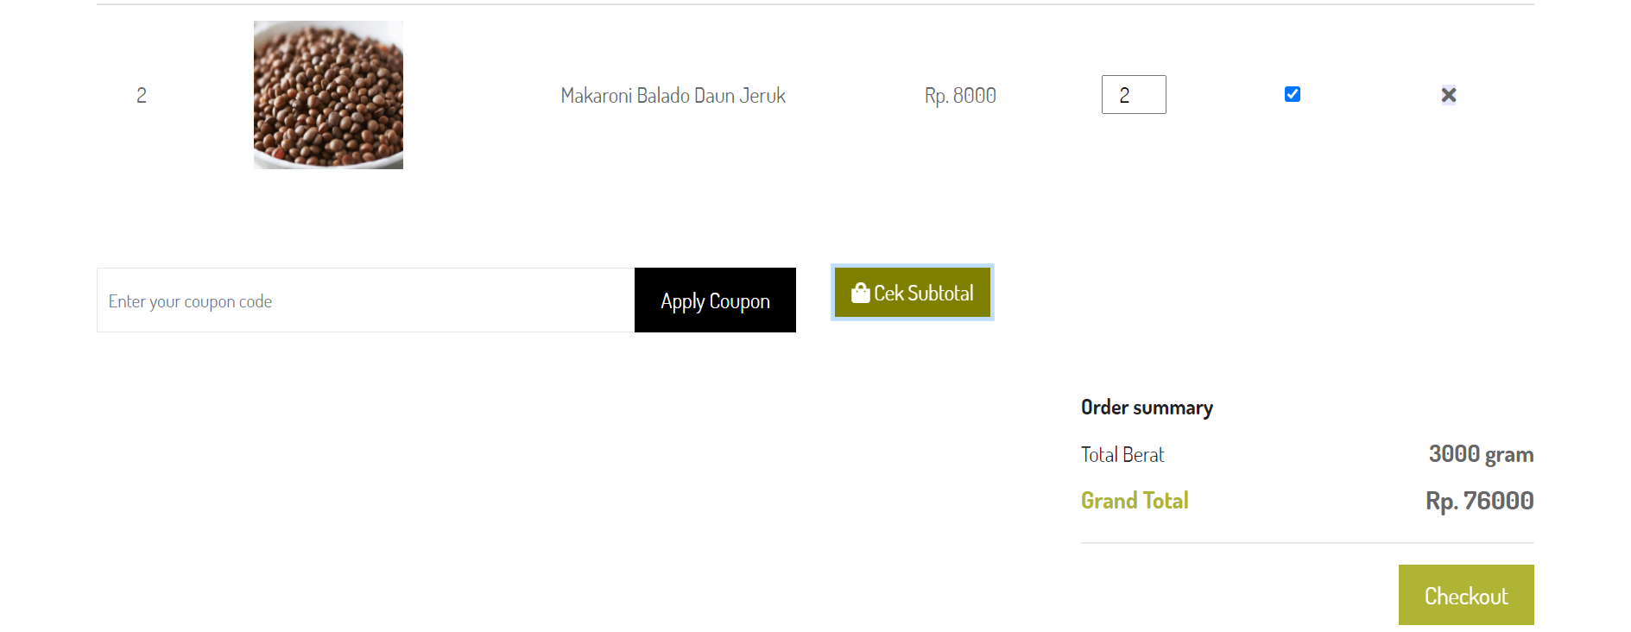
Demo Aplikasi
Halaman Cart
Sales Performance
Service Performance
Sales Honda
Unit Entry
Integrasi data dealer Honda
(termasuk dealer TA)
SSU
Integrasi data
Portal PASTI
Upload data
Portal PASTI
Sale Competitor
Upload dan maintain data
Sales Polreg
Portal PASTI
Market Share
Upload dan maintain data
Upload data dealer kompetitor
Total Market
Portal PASTI
Upload data fincoy

Slide 42
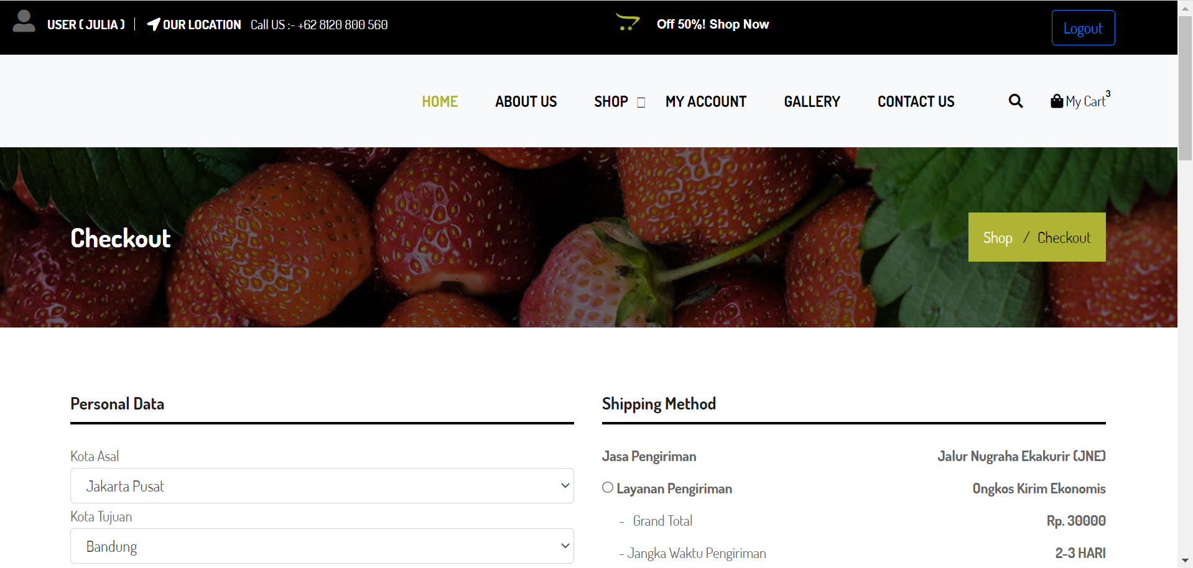
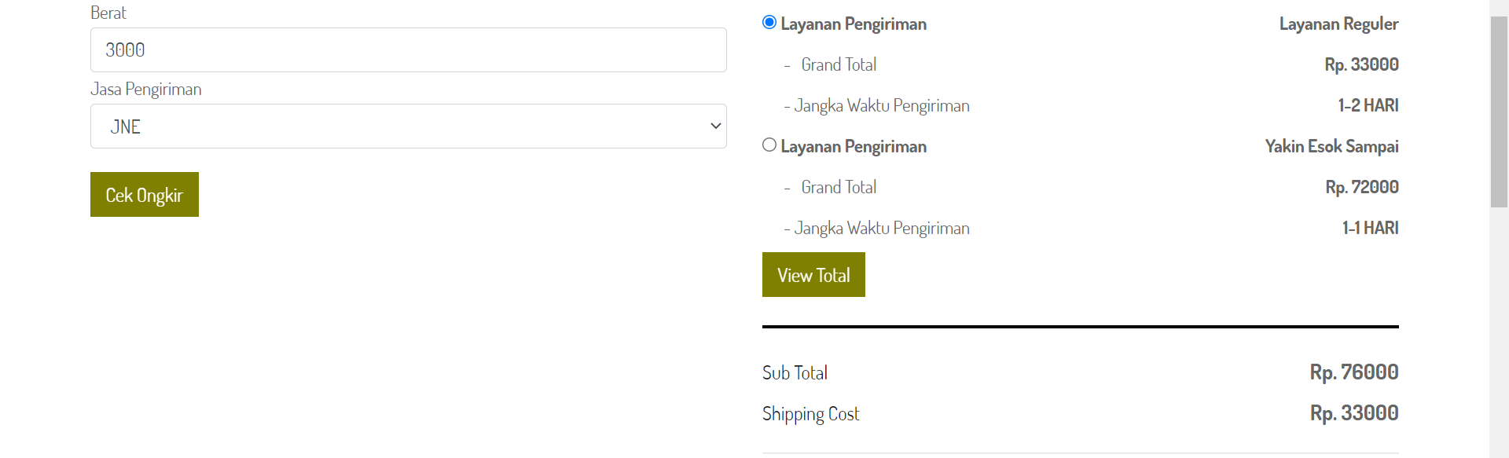
Demo Aplikasi
Halaman Cek Ongkir
Sales Performance
Service Performance
Sales Honda
Unit Entry
Integrasi data dealer Honda
(termasuk dealer TA)
SSU
Integrasi data
Portal PASTI
Upload data
Portal PASTI
Sale Competitor
Upload dan maintain data
Sales Polreg
Portal PASTI
Market Share
Upload dan maintain data
Upload data dealer kompetitor
Total Market
Portal PASTI
Upload data fincoy

Slide 43
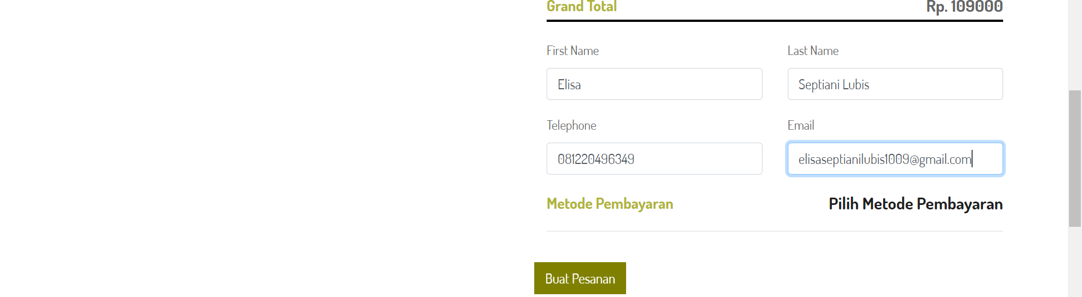
Demo Aplikasi
Halaman Checkout
Sales Performance
Service Performance
Sales Honda
Unit Entry
Integrasi data dealer Honda
(termasuk dealer TA)
SSU
Integrasi data
Portal PASTI
Upload data
Portal PASTI
Sale Competitor
Upload dan maintain data
Sales Polreg
Portal PASTI
Market Share
Upload dan maintain data
Upload data dealer kompetitor
Total Market
Portal PASTI
Upload data fincoy

Slide 44
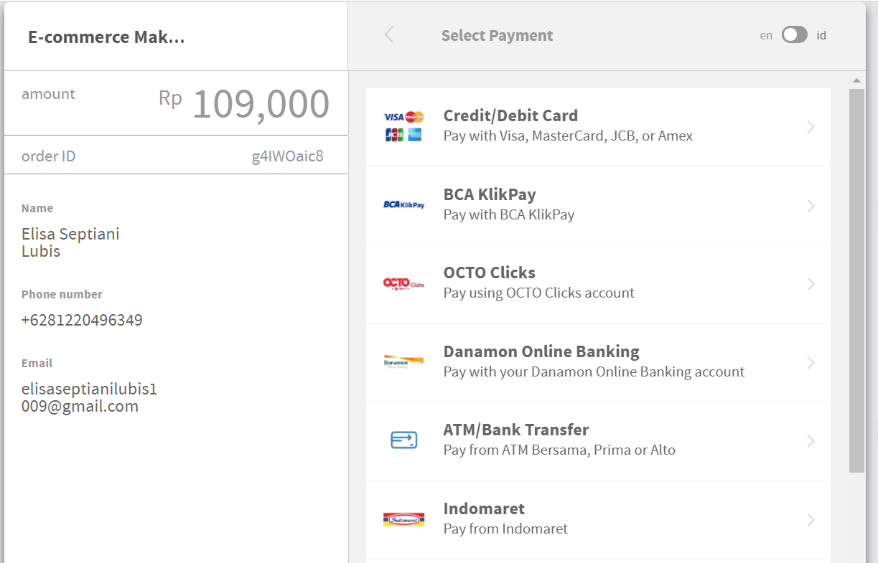
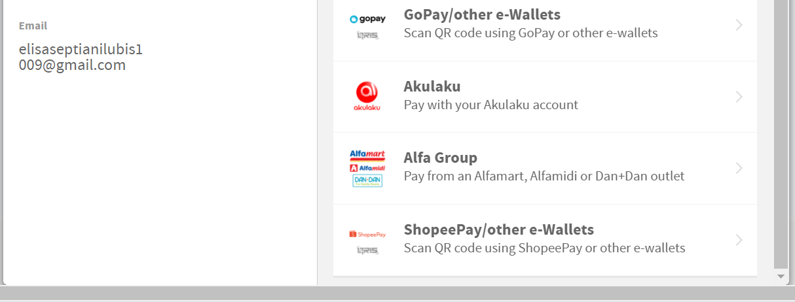
Demo Aplikasi
Halaman Pilih Metode Pembayaran
Sales Performance
Service Performance
Sales Honda
Unit Entry
Integrasi data dealer Honda
(termasuk dealer TA)
SSU
Integrasi data
Portal PASTI
Upload data
Portal PASTI
Sale Competitor
Upload dan maintain data
Sales Polreg
Portal PASTI
Market Share
Upload dan maintain data
Upload data dealer kompetitor
Total Market
Portal PASTI
Upload data fincoy

Slide 45
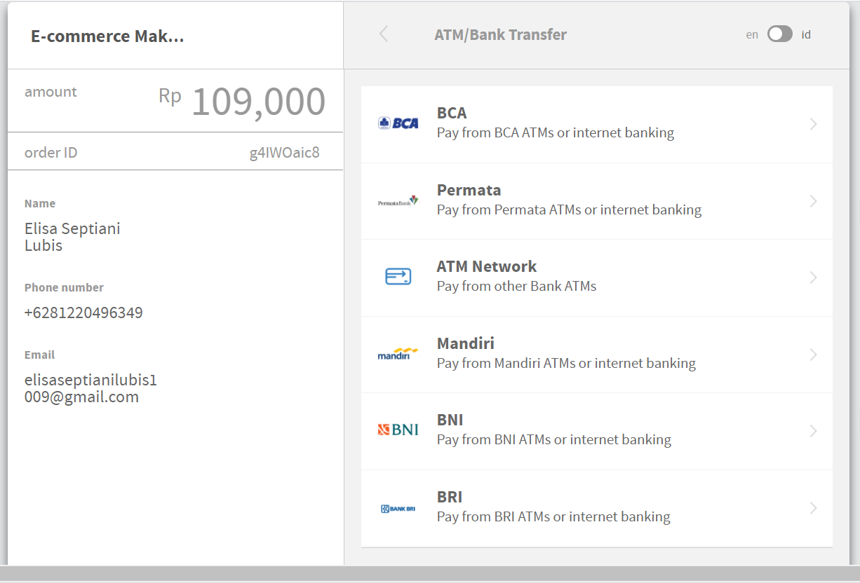
Demo Aplikasi
Halaman Payment Via Bank/Transfer ATM
Sales Performance
Service Performance
Sales Honda
Unit Entry
Integrasi data dealer Honda
(termasuk dealer TA)
SSU
Integrasi data
Portal PASTI
Upload data
Portal PASTI
Sale Competitor
Upload dan maintain data
Sales Polreg
Portal PASTI
Market Share
Upload dan maintain data
Upload data dealer kompetitor
Total Market
Portal PASTI
Upload data fincoy

Slide 46
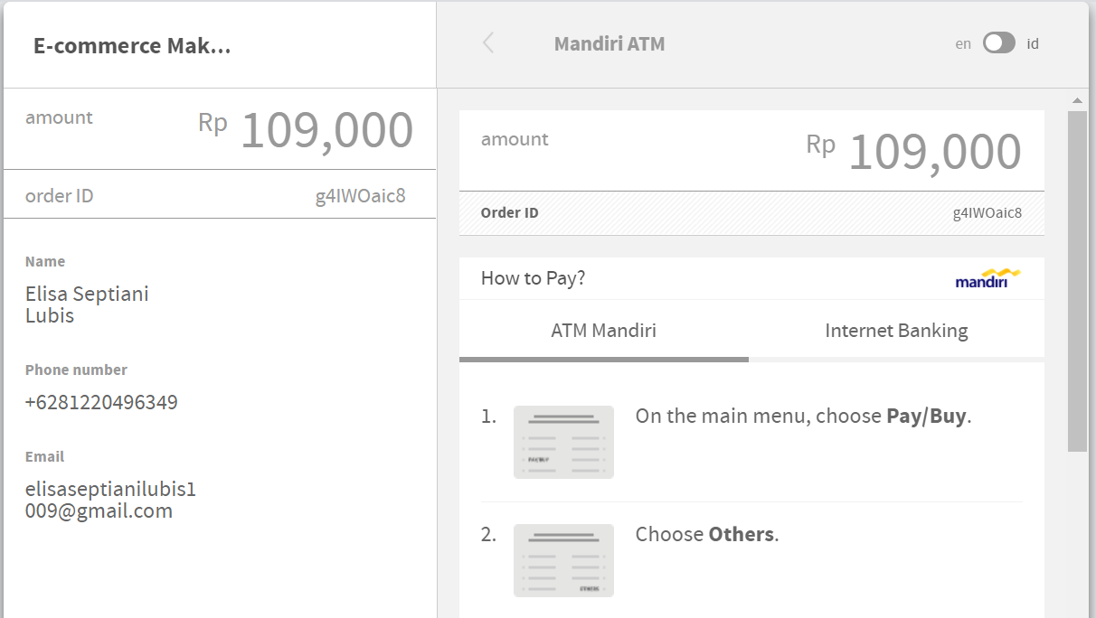
Demo Aplikasi
Halaman Payment Via Bank Mandiri
Sales Performance
Service Performance
Sales Honda
Unit Entry
Integrasi data dealer Honda
(termasuk dealer TA)
SSU
Integrasi data
Portal PASTI
Upload data
Portal PASTI
Sale Competitor
Upload dan maintain data
Sales Polreg
Portal PASTI
Market Share
Upload dan maintain data
Upload data dealer kompetitor
Total Market
Portal PASTI
Upload data fincoy

Slide 47
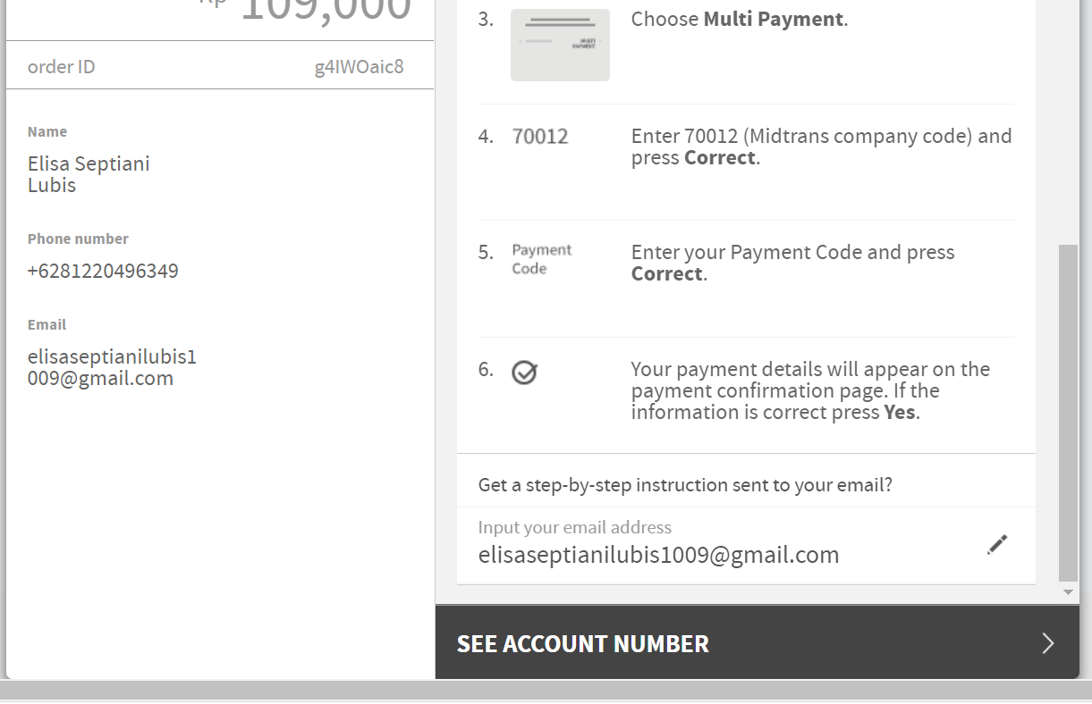
Demo Aplikasi
Halaman Payment Via Bank Mandiri
Sales Performance
Service Performance
Sales Honda
Unit Entry
Integrasi data dealer Honda
(termasuk dealer TA)
SSU
Integrasi data
Portal PASTI
Upload data
Portal PASTI
Sale Competitor
Upload dan maintain data
Sales Polreg
Portal PASTI
Market Share
Upload dan maintain data
Upload data dealer kompetitor
Total Market
Portal PASTI
Upload data fincoy

Slide 48
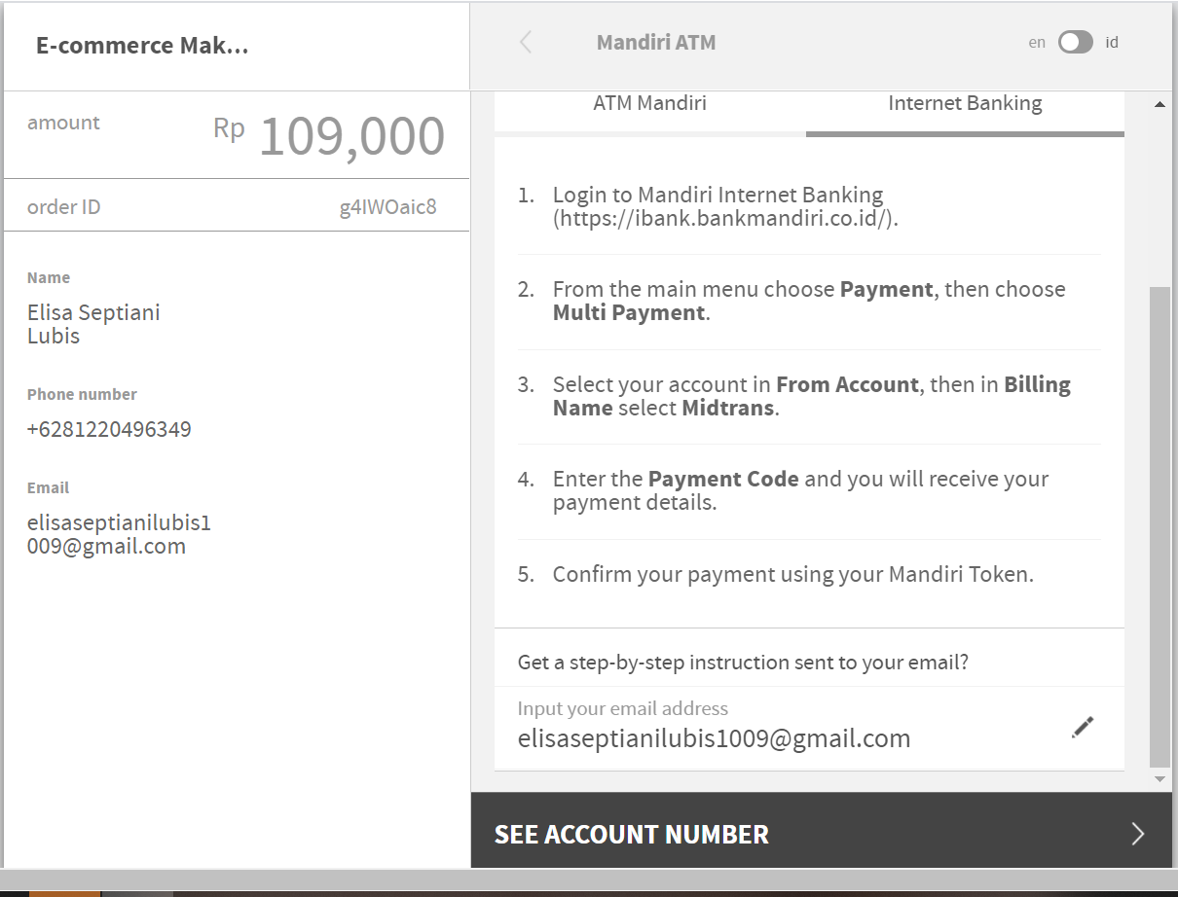
Demo Aplikasi
Halaman Payment Via Bank Mandiri
Sales Performance
Service Performance
Sales Honda
Unit Entry
Integrasi data dealer Honda
(termasuk dealer TA)
SSU
Integrasi data
Portal PASTI
Upload data
Portal PASTI
Sale Competitor
Upload dan maintain data
Sales Polreg
Portal PASTI
Market Share
Upload dan maintain data
Upload data dealer kompetitor
Total Market
Portal PASTI
Upload data fincoy

Slide 49
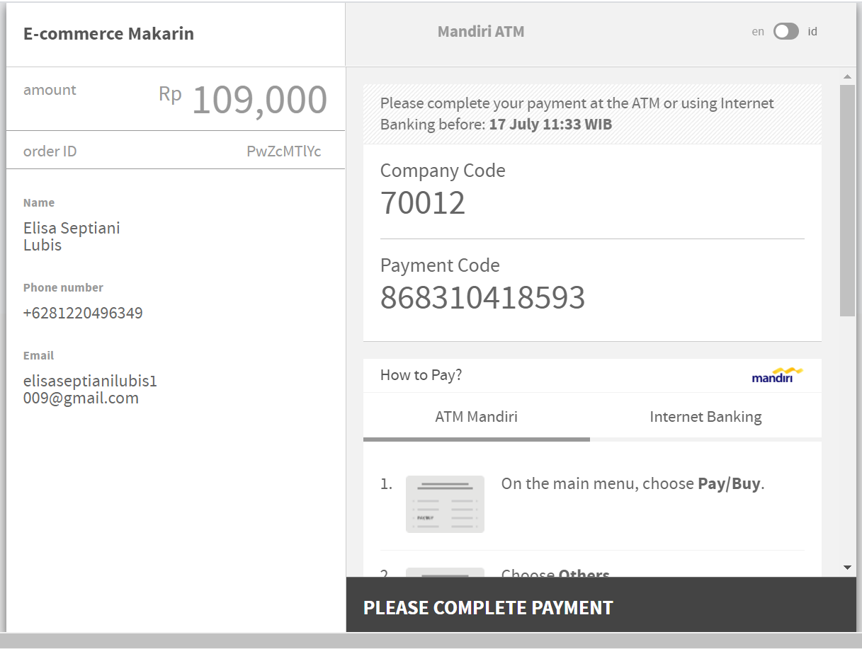
Demo Aplikasi
Halaman Kode Pembayaran Bank Mandiri
Sales Performance
Service Performance
Sales Honda
Unit Entry
Integrasi data dealer Honda
(termasuk dealer TA)
SSU
Integrasi data
Portal PASTI
Upload data
Portal PASTI
Sale Competitor
Upload dan maintain data
Sales Polreg
Portal PASTI
Market Share
Upload dan maintain data
Upload data dealer kompetitor
Total Market
Portal PASTI
Upload data fincoy

Slide 50
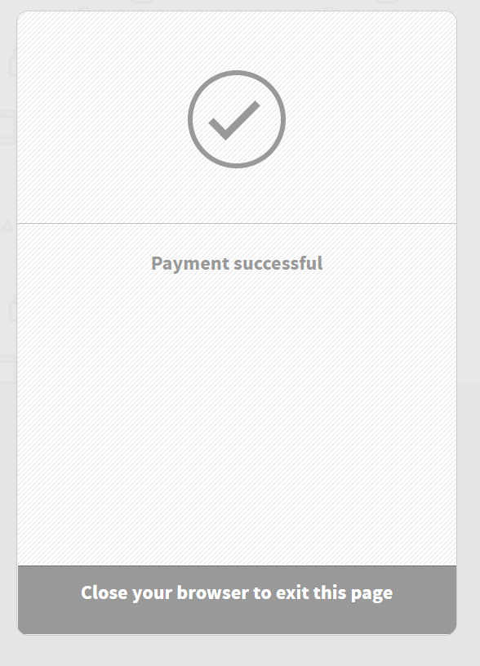
Demo Aplikasi
Halaman Notifikasi Sukses Pembayaran
Sales Performance
Sales Honda
Integrasi data dealer Honda
(termasuk dealer TA)
SSU
Integrasi data
Portal PASTI
Sale Competitor
Upload dan maintain data
Sales Polreg
Portal PASTI
Market Share
Upload dan maintain data
Total Market

Slide 51
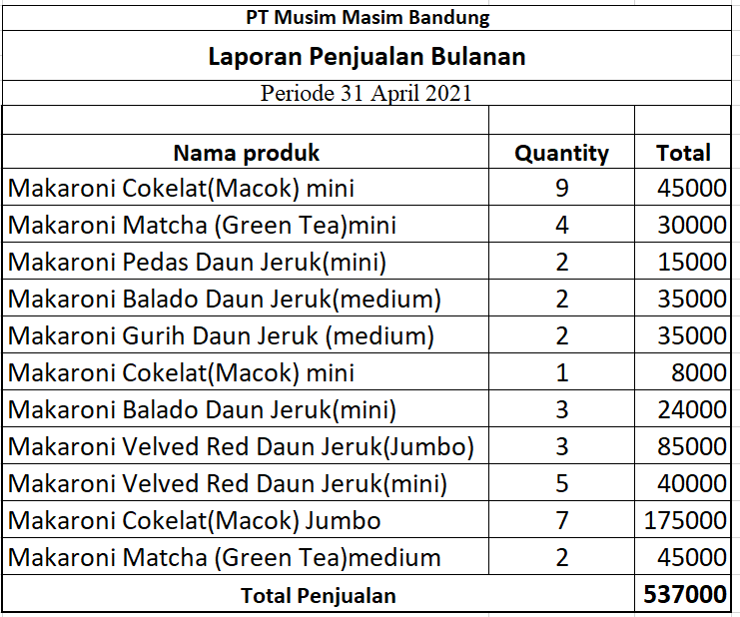
Demo Aplikasi
Halaman Laporan Penjualan
Sales Performance
Sales Honda
Integrasi data dealer Honda
(termasuk dealer TA)
SSU
Integrasi data
Portal PASTI
Sale Competitor
Upload dan maintain data
Sales Polreg
Portal PASTI
Market Share
Upload dan maintain data
Total Market

Slide 52
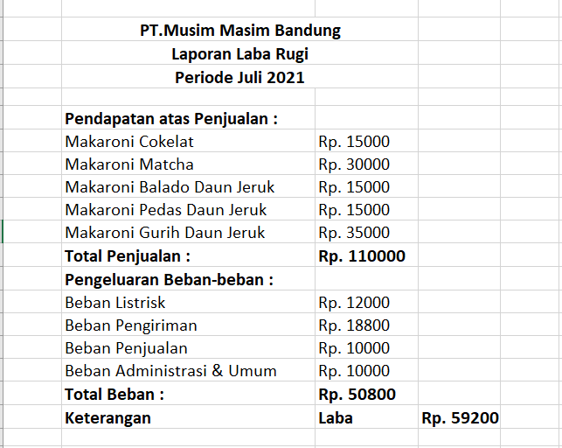
Demo Aplikasi
Halaman Laporan Laba Rugi
Sales Performance
Sales Honda
Integrasi data dealer Honda
(termasuk dealer TA)
SSU
Integrasi data
Portal PASTI
Sale Competitor
Upload dan maintain data
Sales Polreg
Portal PASTI
Market Share
Upload dan maintain data
Total Market

Slide 53
Kesimpulan dan saran
Kesimpulan
Bagi UMKM :
Dengan dibangunnya website sistem informasi manajemen dan marketing usaha makaroni MASIM ini, diharapkan dapat menjadi media alternative untuk untuk membantu mengoptimalkan pengelolaan data, transaksi dan pemasaran produk agar prospek penjualan meningkat secara signifikan.
Bagi Pelanggan:
Dapat mempermudah pelanggan makaroni masim dalam hal transaksi dimanapun dan kapanpun.
Saran
Sistem website informasi manajemen dan marketing usaha makaroni MASIM perlu dikembangkan lagi agar kinerja aplikasi menjadi lebih baik.
Diantaranya :
Website ini bisa ditambahkan fitur Cek Resi Pengiriman, fitur multimedia seperti ulasa video testimoni dan laporan peningkatan penjualan sesuai filter tahun.

Slide 54


